Slide 1
Chapter 9
DIRECT DETERMINATION OF THE ELASTIC CURVE
FROM THE LOAD DISTRIBUTION

Slide 2
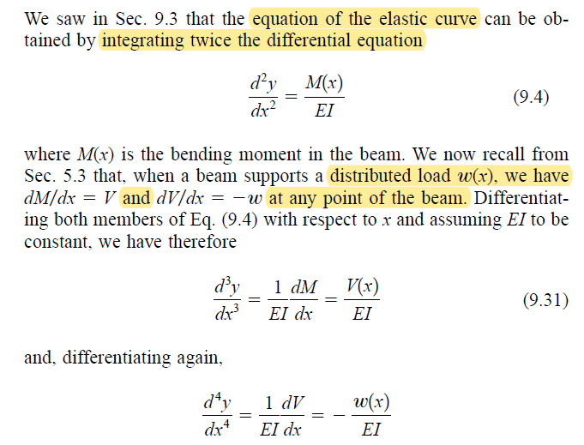

Slide 3


Slide 4
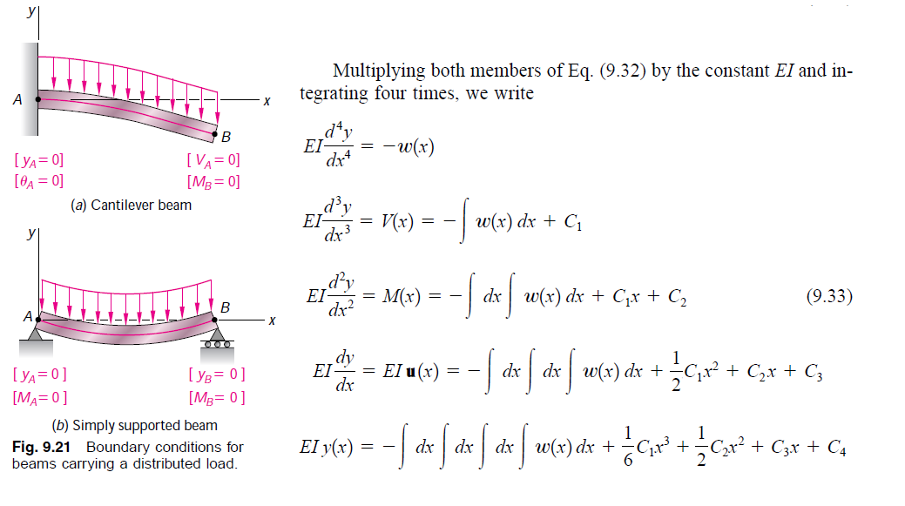

Slide 5
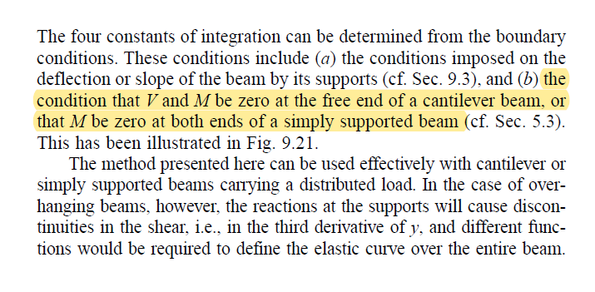

Slide 6


Slide 7
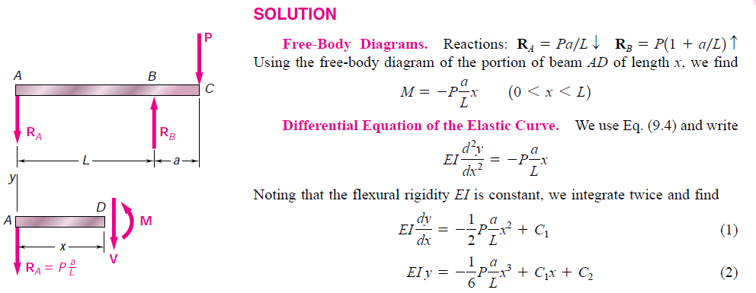

Slide 8


Slide 9
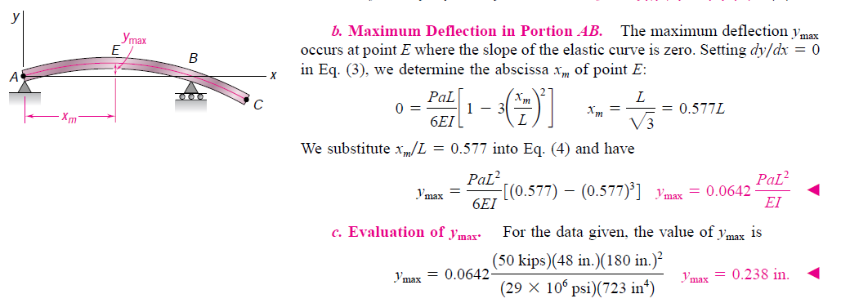

Slide 10


Slide 11
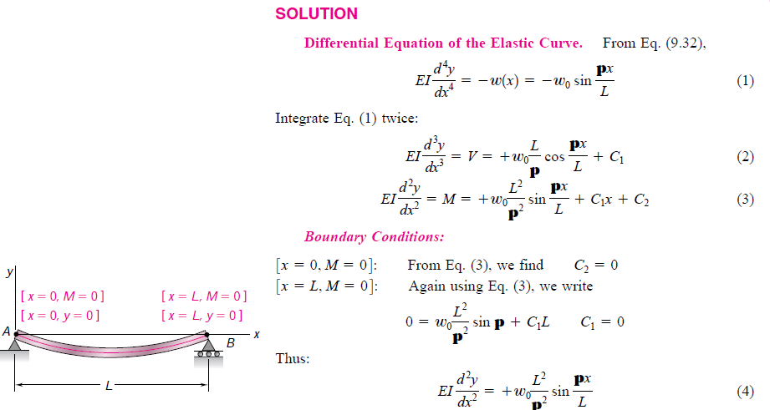

Slide 12
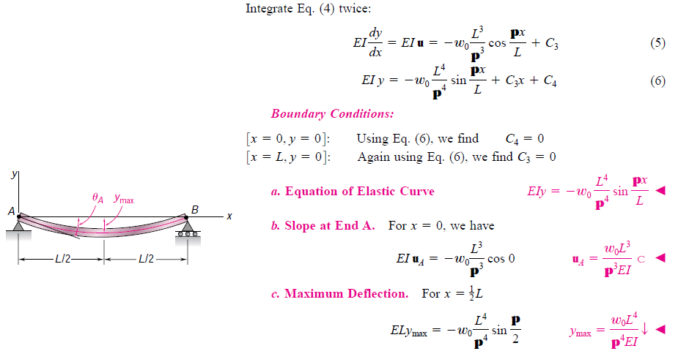

Slide 13
End Chapter Problems
9.1-9.3, 9.5-9.9

Slide 14
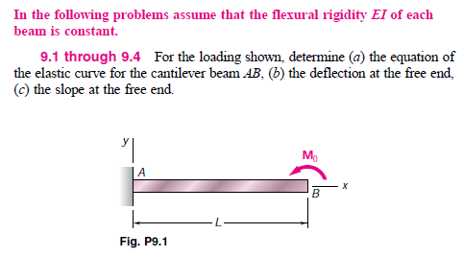

Slide 15
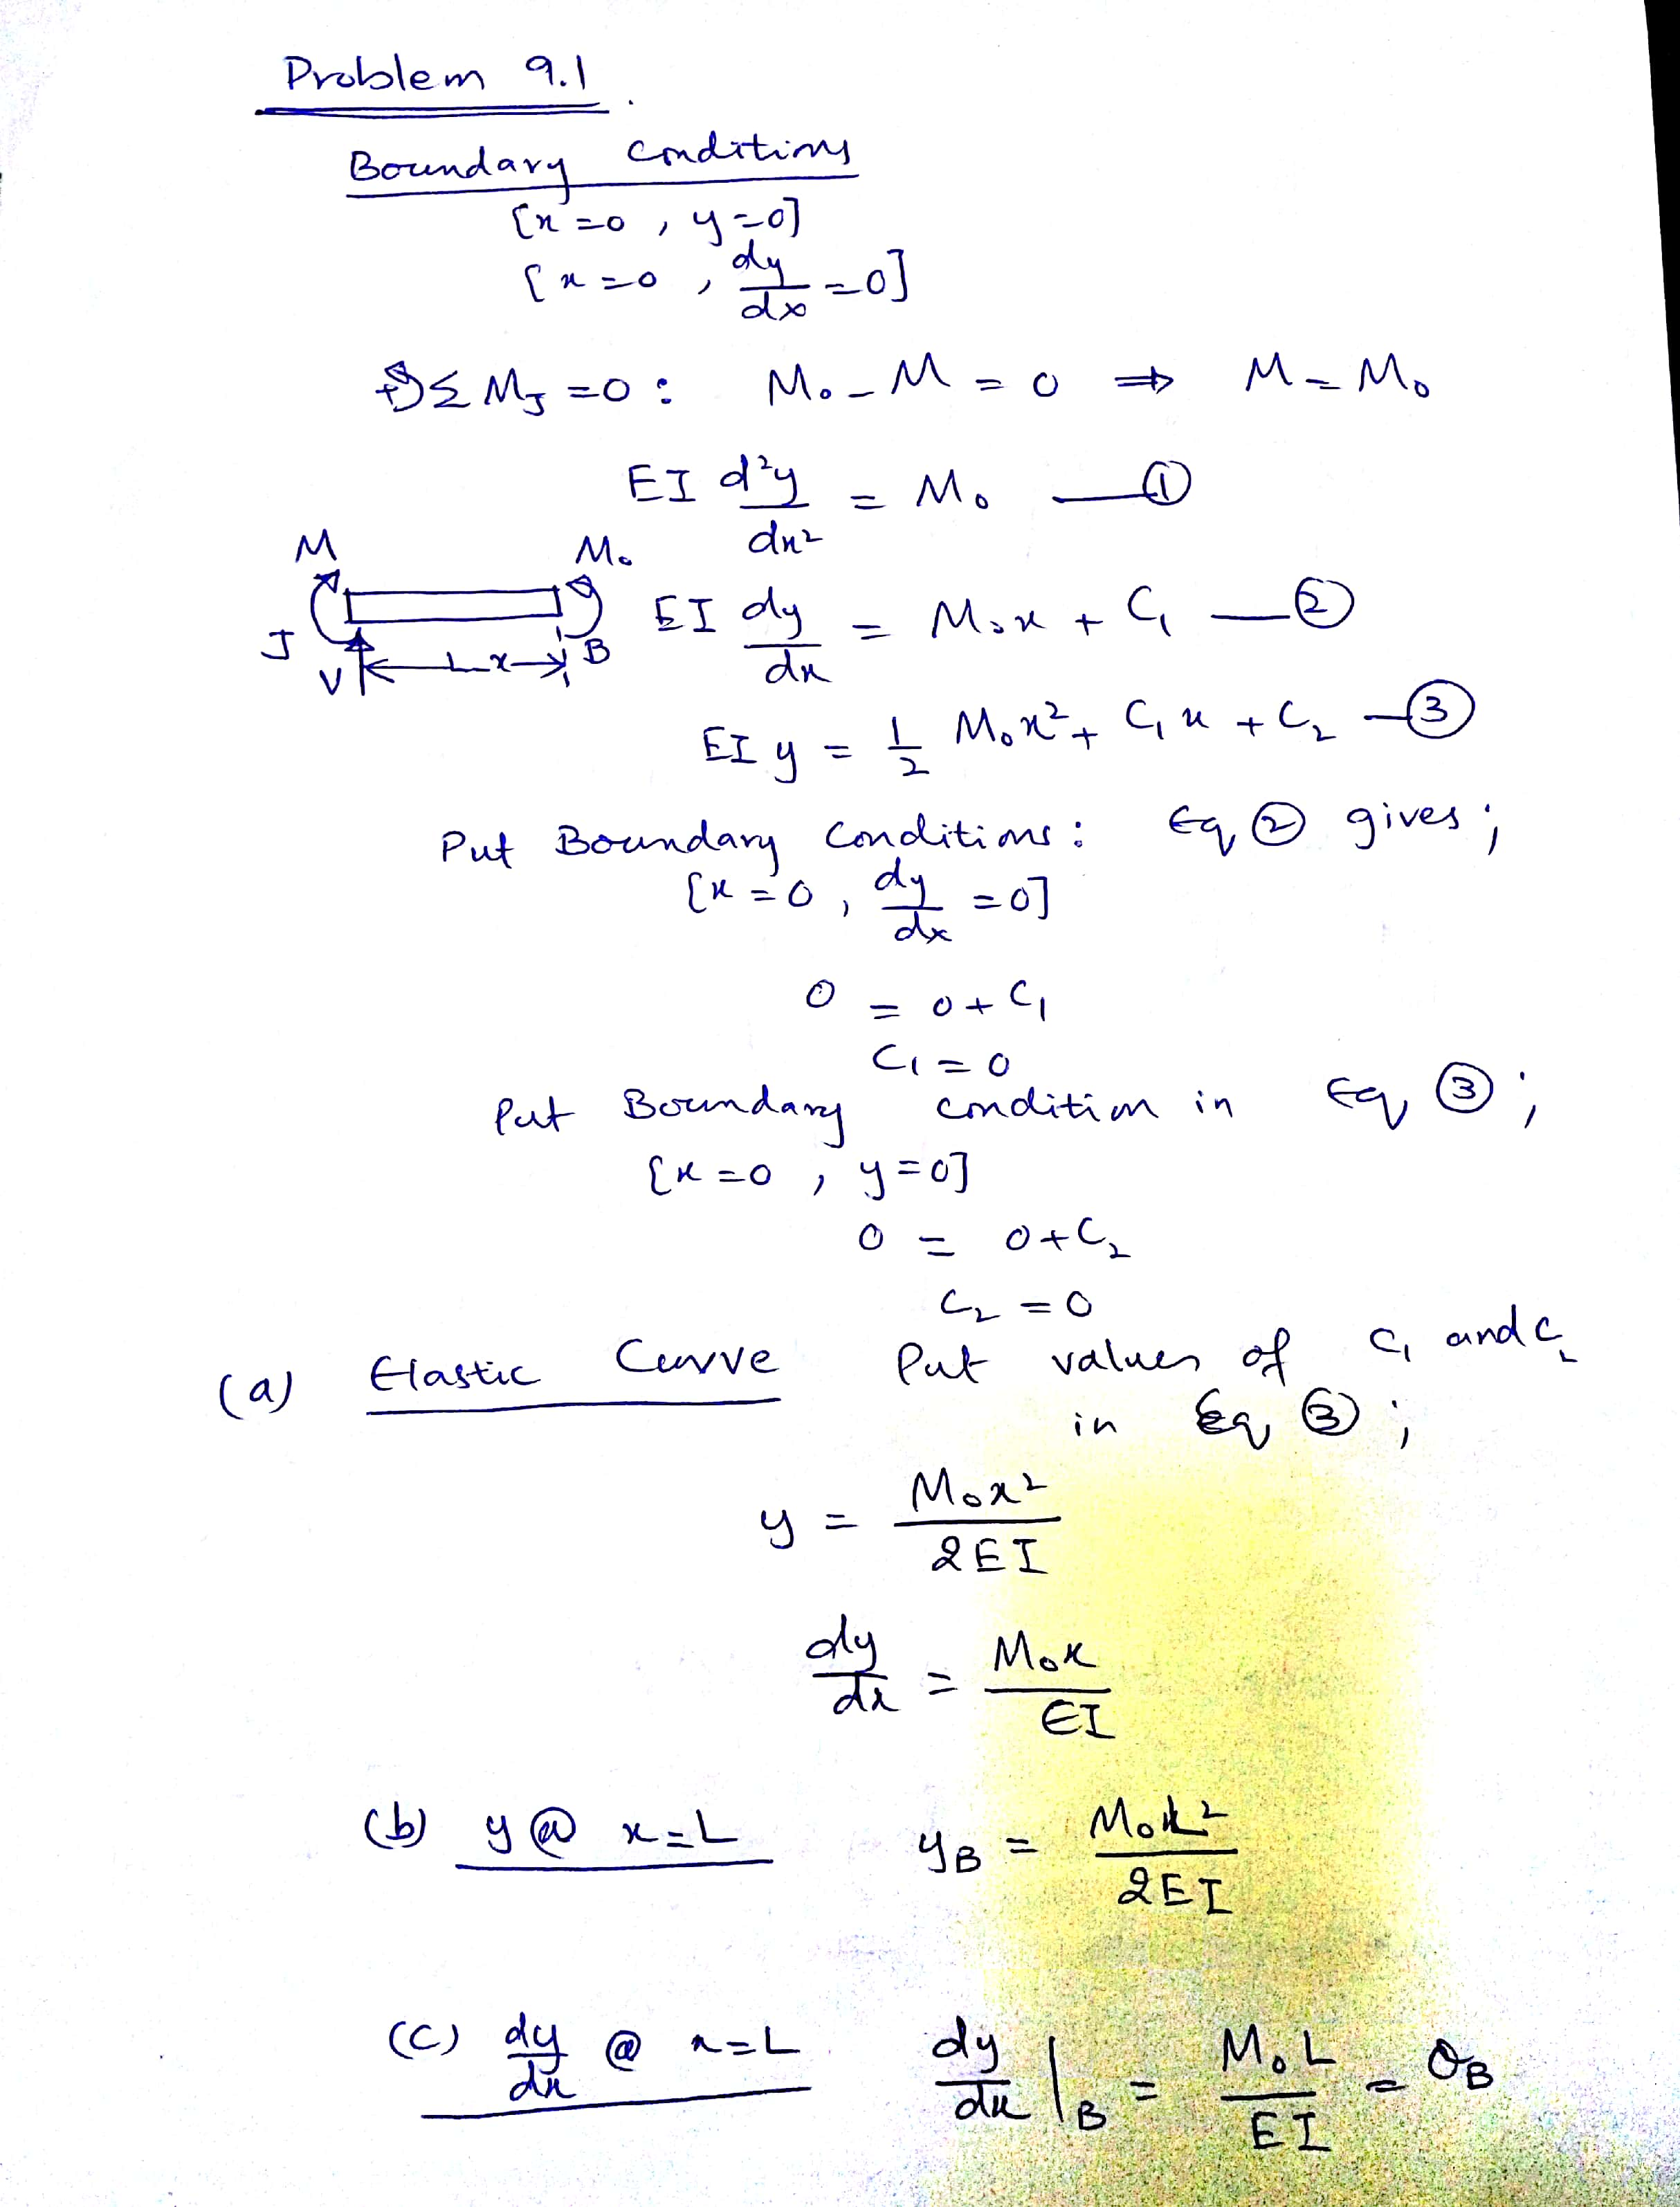

Slide 16
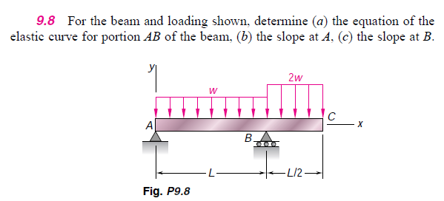

Slide 17
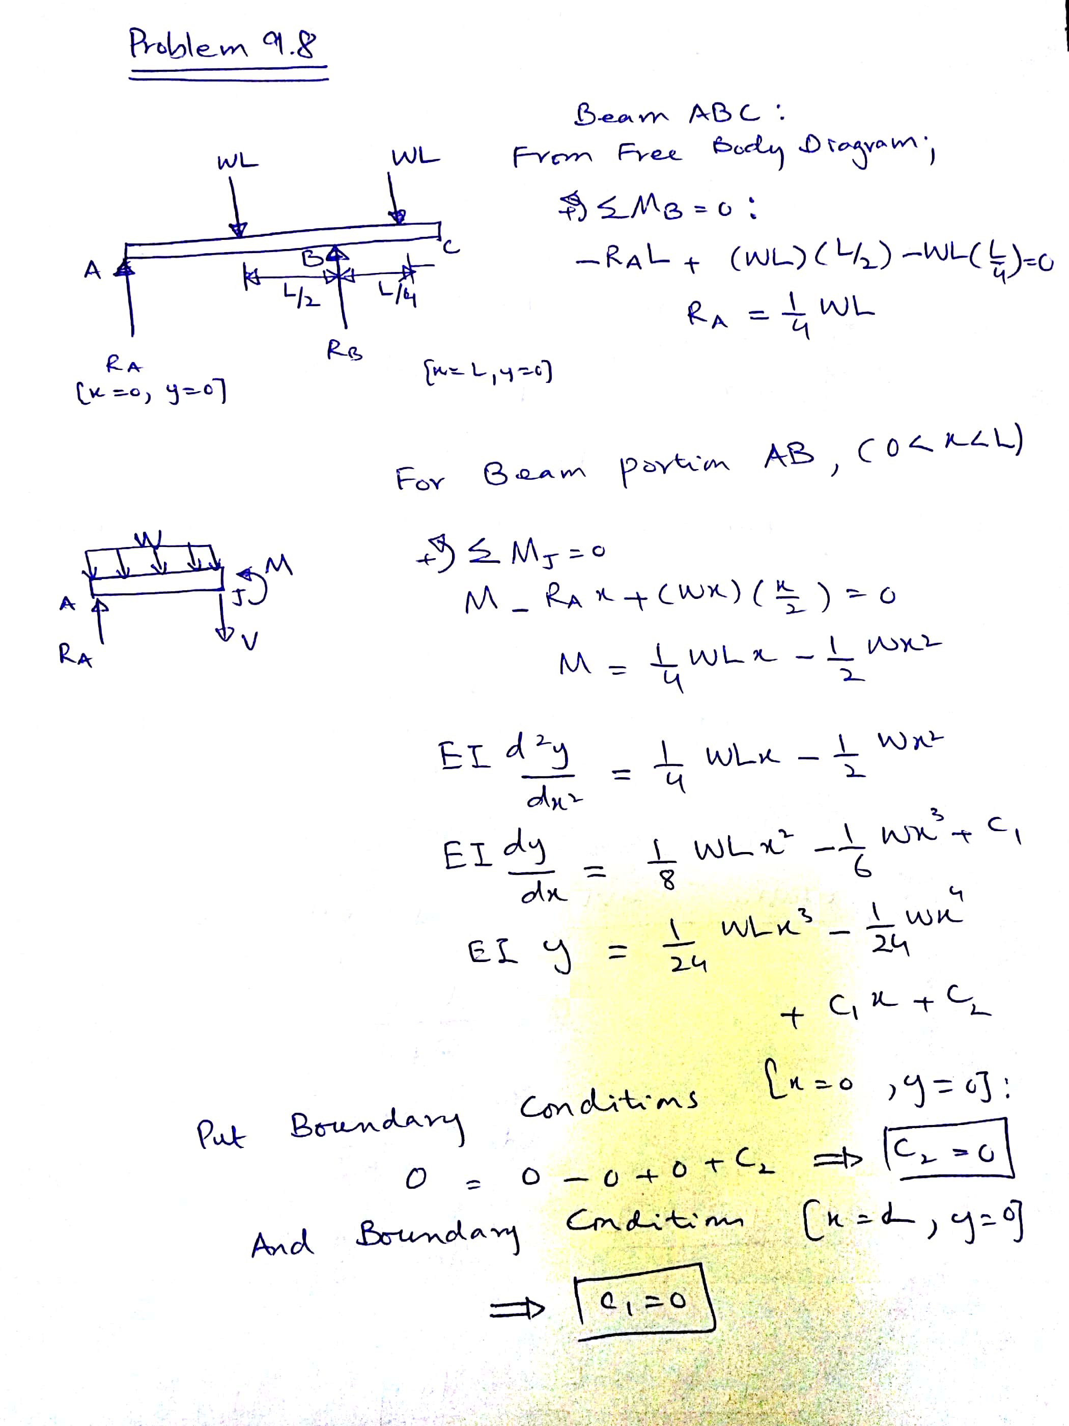

Slide 18
